Slide 1
Leveraging Lifecycle Modeling to Integrate Systems Engineering and Project Management
Sarah Rudder, PE, CSEP
Principal Systems Engineer, Enola Technologies

Slide 2
Agenda
8:00am Mod 2 - Overview of Lifecycle Modeling Language (LML)
8:15am Mod 3 - Introduction to Innoslate
8:30am Mod 4 - Requirements Management (RM)
8:45am Mod 4 – Lab
9:15am BREAK
9:30am Mod 5 – Lifecycle Management Framework (LMF)
9:45am Mod 6 – Structural Architecture
10:00am Mod 6 – Lab
10:30am BREAK
10:45am Mod 7 – Functional Architecture
11:00am Mod 7 – Lab
11:30am Mod 8 – Project Management
11:45am Mod 8 - Lab

Slide 3
Instructor Background
SE Community Involvement
Experience
Active Member, INCOSE Orlando Chapter
Active Member, INCOSE Space Systems Working Group (SSWG)
Secretary, Lifecycle Modeling Organization
Principal Systems Engineer, Enola Technologies (current)
Collaborative Engagement Capability (CEC), Raytheon Missiles and Defense (RMD), St. Pete, FL
Raytheon Intelligence and Space (RIS), Richardson, TX
Uranium Processing Facility (UPF), Oak Ridge, TN
Hanford Tank Waste Treatment and Immobilization Plant (WTP), Hanford WA
Education
Colorado State University, PhD, Systems Engineering (current)
University of Tennessee, M.S., Industrial and Systems Engineering
Auburn University, B.S., Biosystems Engineering

Slide 4
Rules of Engagement
I encourage listening to the lecture portions prior to beginning the lab sections
Please hold questions until the end of each module lectures
Participate in the lab for a comprehensive learning experience
Follow-up questions can be directed to sarah.rudder@enolatech.com

Slide 5
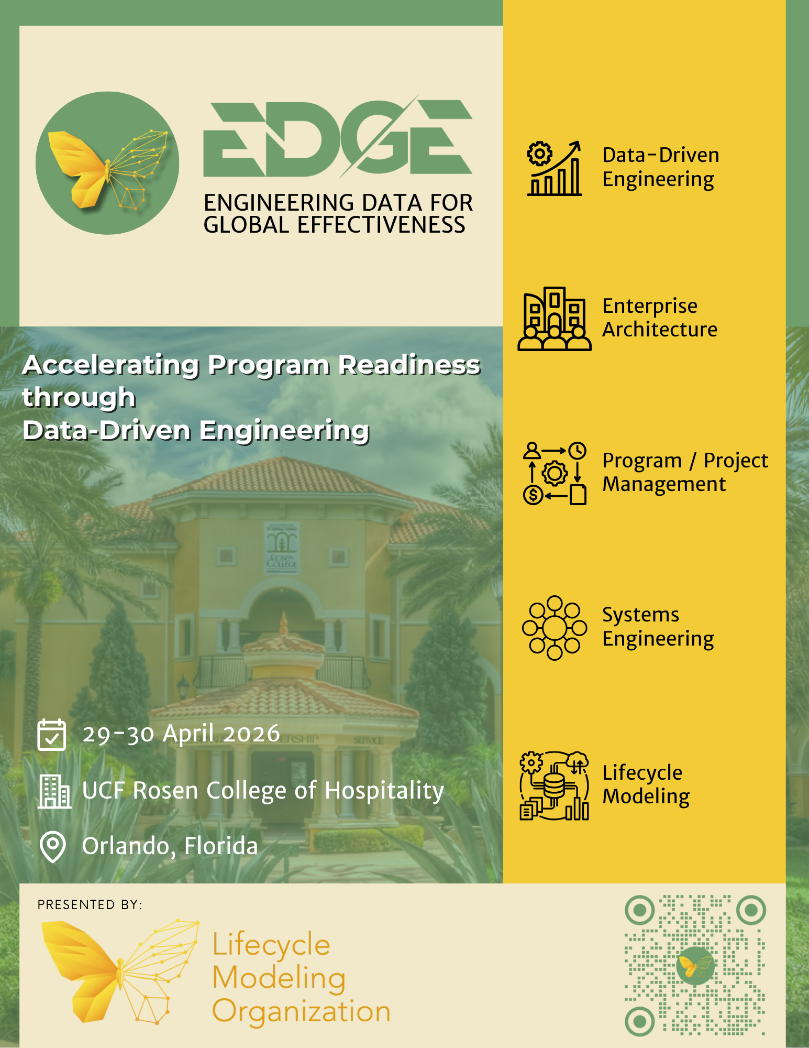

LML Open-source Resources
Lifecycle Modeling Organization (LMO) - https://www.lifecyclemodeling.org/
LML v2 specification - https://www.lifecyclemodeling.org/specification
Lifecycle Model-based Systems Engineering (LMBSE) - https://www.lmbse.com/courses
SPEC Innovations Webinars - https://specinnovations.com/webinars

Slide 6

INCOSE MBSE Definition
“Model-based systems engineering (MBSE) is the formalized application of modeling to support system requirements, design, analysis, verification and validation activities beginning in the conceptual design phase and continuing throughout development and later life cycle phases.”
INCOSE SE Vision 2020 (INCOSE-TP-2004-004-02, Sep 2007)
Notes:
Give my own definition of MBSE

Slide 7
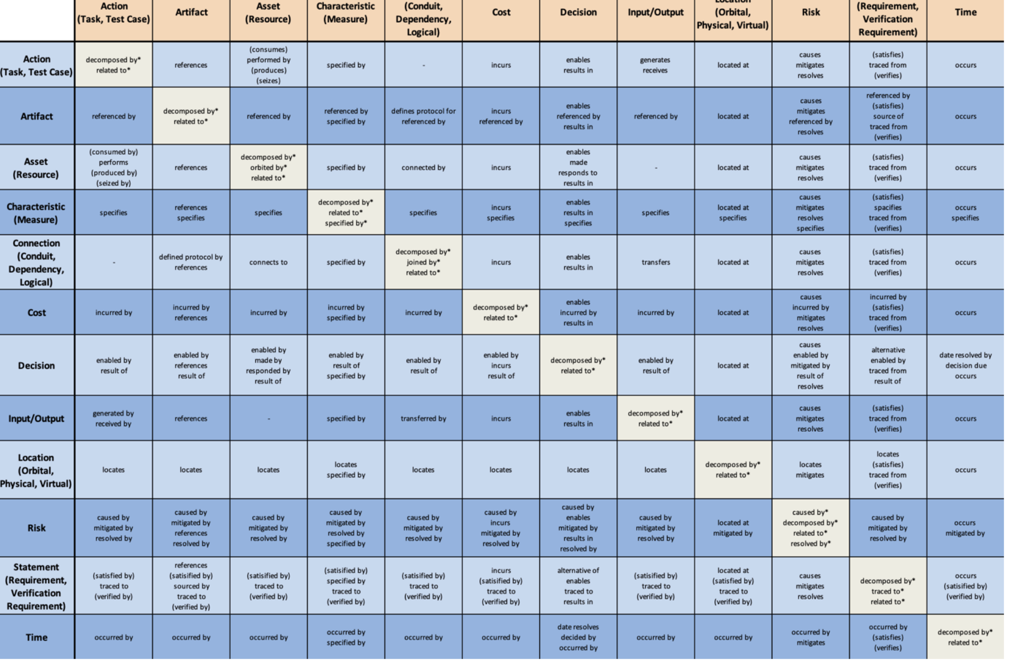
MBSE Success
Modeling languages capture a formalized ontology (i.e., internal logic) to connect relationships along with standards to facilitate interoperability between tools
Subject-predicate-object (SPO) approach

Slide 8
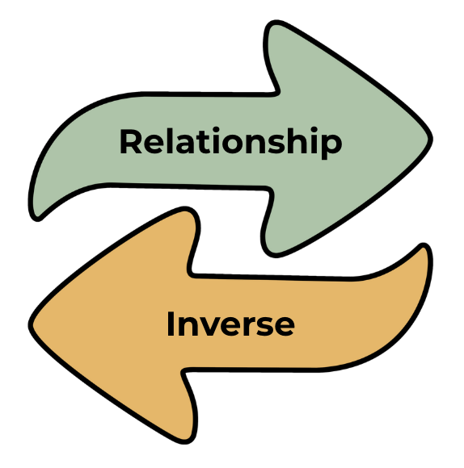
Predicate Triples
LML relationships are based on a subject-predicate-object (SPO) approach
Each predicate has an inverse
Limits ambiguity for interpretation
Can account for multiplicity
Example:
Risk is caused by an action
An action causes a risk
Subject | Predicate | Object
Risk | caused by | Action
Action | causes | Risk

Slide 9
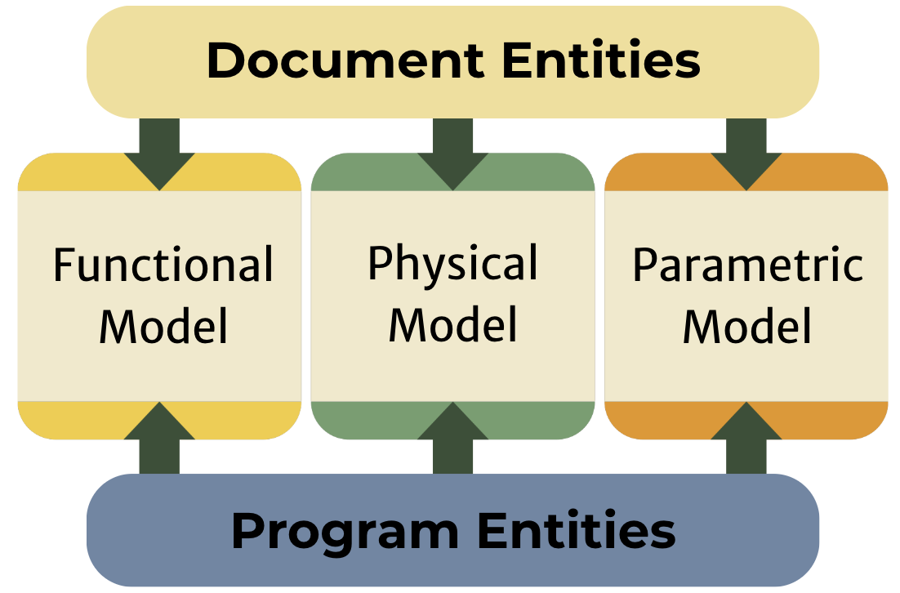
LML Overview
The LML is a standardized language for applying MBSE
Documentation elements (e.g., artifacts)
Program entities (e.g., cost, risk)
Physical Model
Assets
Functional Model
Actions
Inputs/Outputs

Slide 10
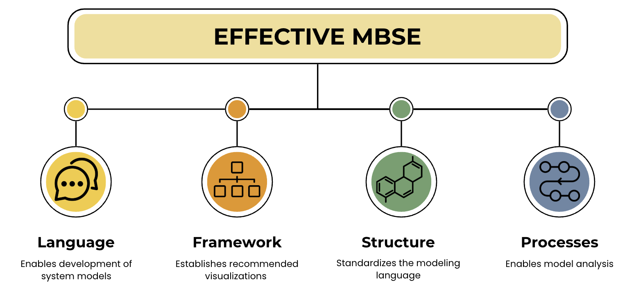

Slide 11
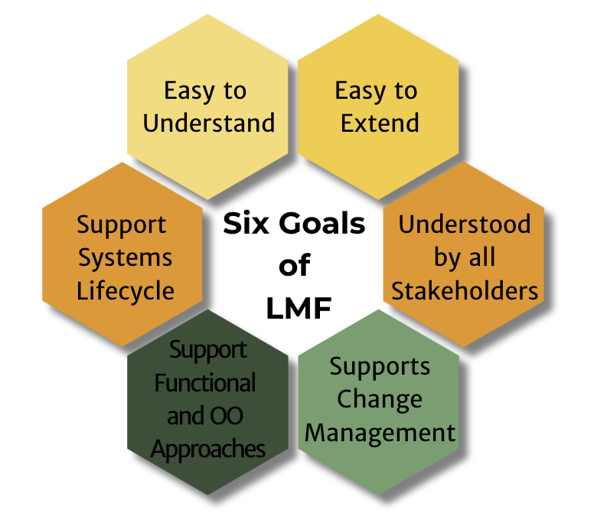

Slide 12
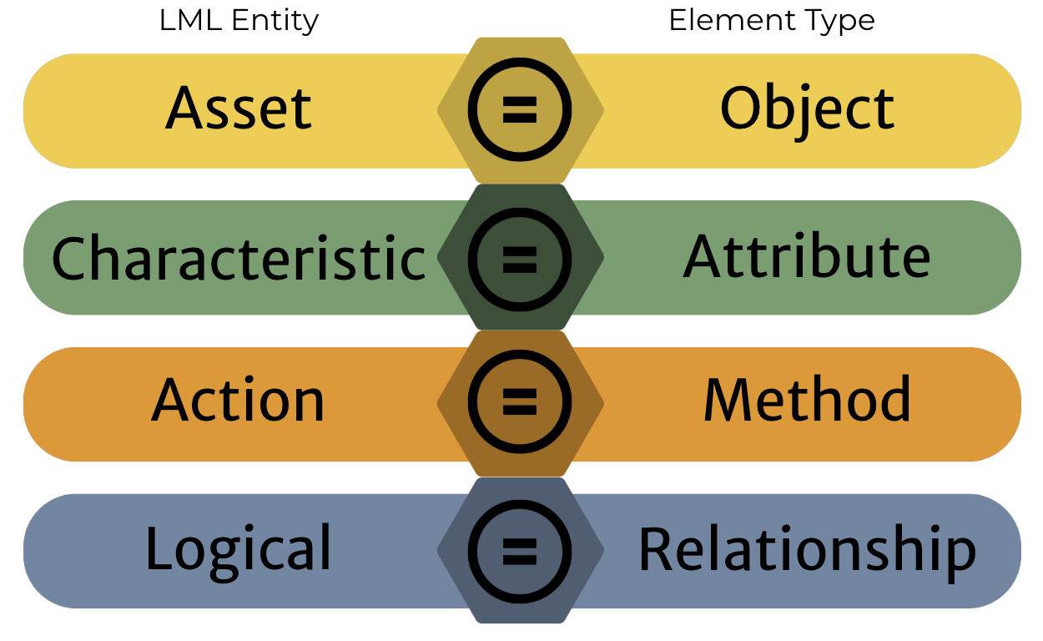
LML Metamodel

Slide 13
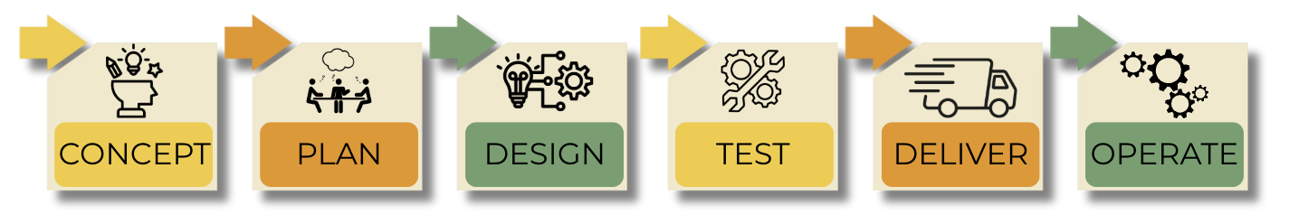
Product Lifecycle

Slide 14
LML Entities

Slide 15
Actions
An Action entity specifies the mechanism by which inputs are transformed into outputs
A Task entity specifies an Action that must be completed for a particular project. It serves as a "ToDo" for the Project
A Test Case entity specifies a verification or validation task, and its expected and actual results
Event
Capability
Activity
Function
Process
V&V
Demonstration
Notes:
Example of underlying semantics

Slide 16
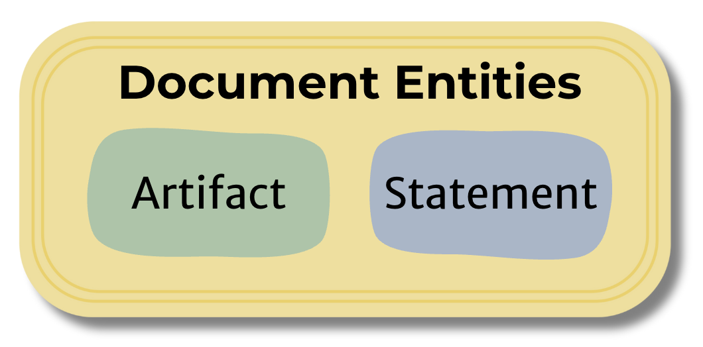
Artifact
Asset
An Artifact entity specifies a document or other source of information that is referenced by or generated in the knowledge base
An Asset entity specifies an object, person, or organization that performs Actions, such as a system, subsystem, component, or element
A Resource entity specifies a consumable or producible Asset
Notes:
Examples include: document, email, procedure, specification

Slide 17
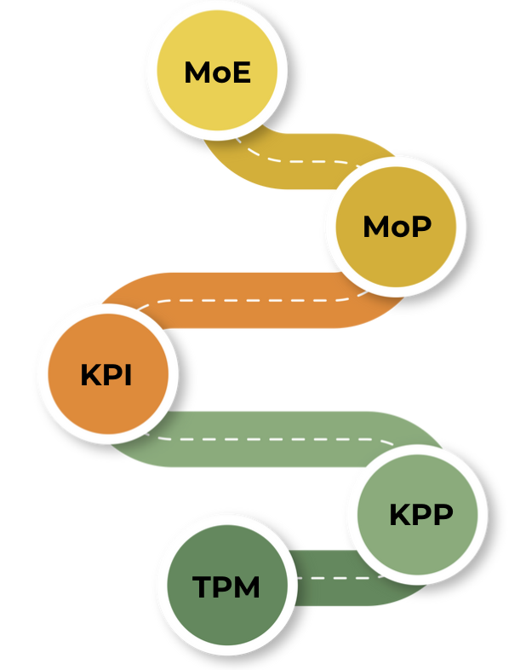
Characteristic
Measure
A Characteristic entity specifies or captures properties of an entity
Examples include:
Attribute
Category
Power
Color
Role
Size
Weight
A Measure entity specifies the set of measurements used to provide insight into the system definition
Notes:
Performance measurements

Slide 18
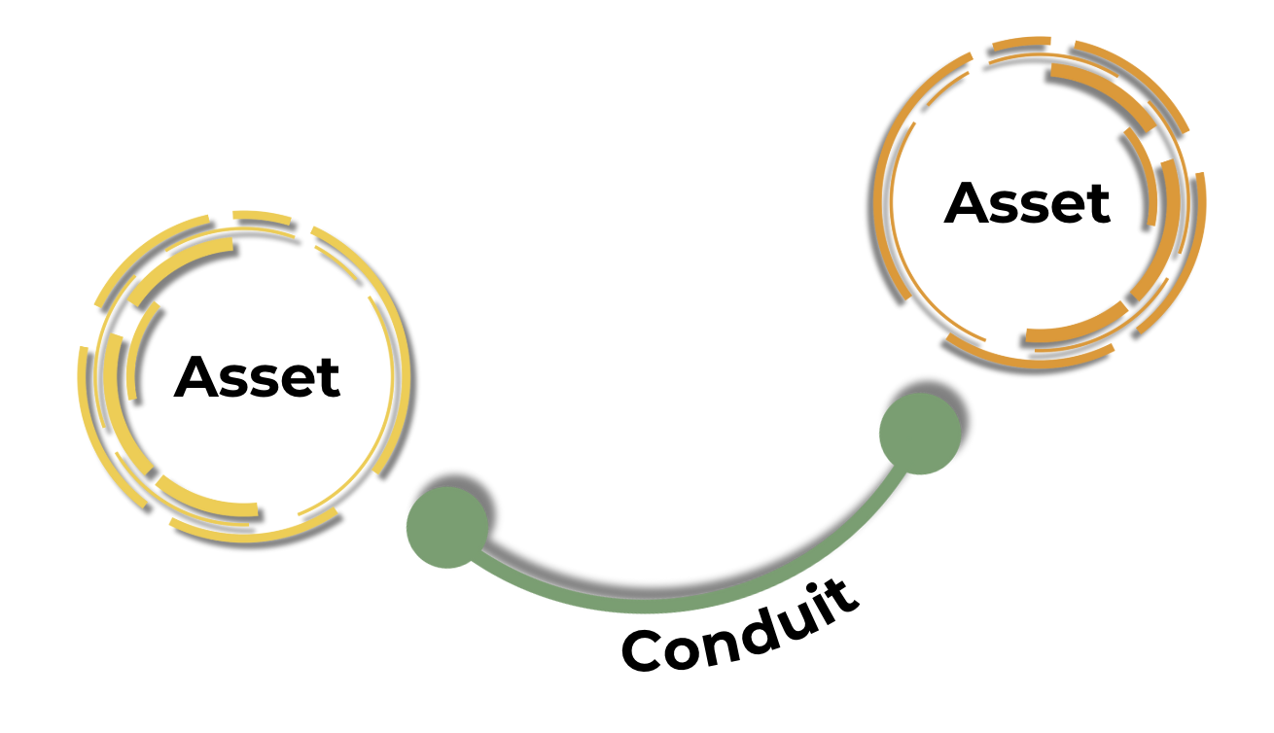
Connection
A Connection entity specifies the means for relating Asset instances to each other.
A Conduit entity specifies the means for physically transporting Input / Output entities between Asset entities
A Dependency entity specifies a connection between two Tasks in a Gantt Chart
A Logical entity represents the abstraction of the relationship between two entities (e.g., Asset entities with the type “Entity”)
Notes:
Conduit - It has limitations (i.e., attributes) of capability and latency
Dependency - It defines the relationship a Task depends on another Task in order to Start or Finish.

Slide 19
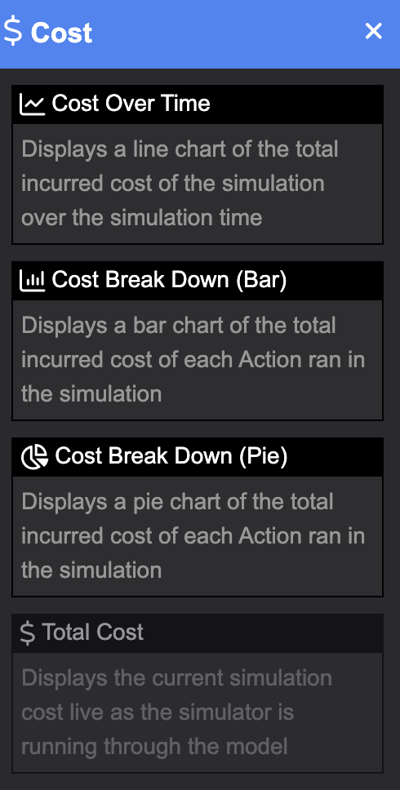
Cost
A Cost entity specifies the outlay or expenditure made to achieve an objective associated with another entity
Types of cost include: earned value, actual, planned

Slide 20
Decision
Input/Output
A Decision entity specifies a challenge and its resolution
An Input/Output entity specifies the information, data, or object input to, trigger, or output from an Action
Can be logical or physical
Types include items, data, energy

Slide 21
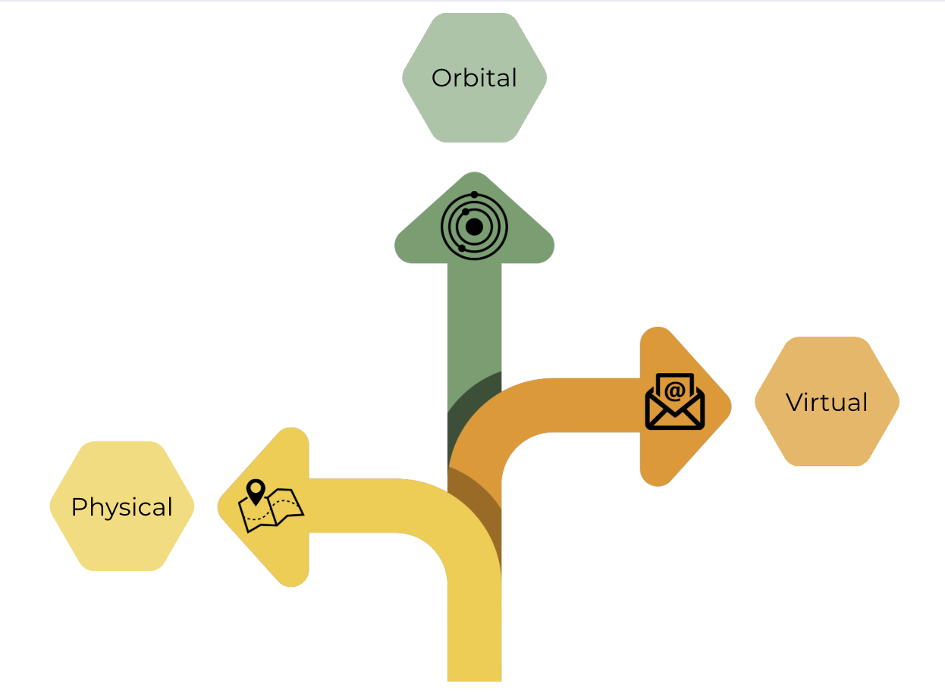
Location
A Location entity specifies where an entity resides
An Orbital entity specifies a location along an orbit around a celestial body (e.g., low-orbit)
A Physical entity specifies a location on, above, or below the surface (e.g., latitude/longitude)
A Virtual entity specifies a location within a digital network (e.g., URL)

Slide 22
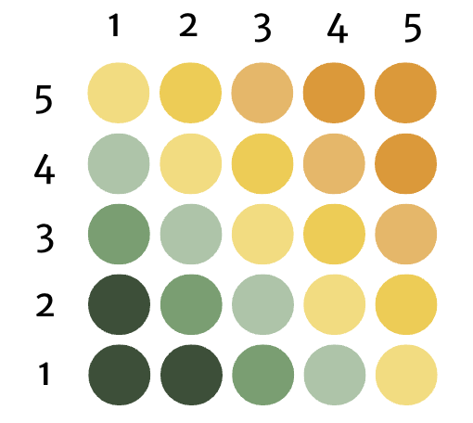
Risk
A Risk entity specifies the combined probability and consequence in achieving objectives
Cost
Technical
Schedule

Slide 23
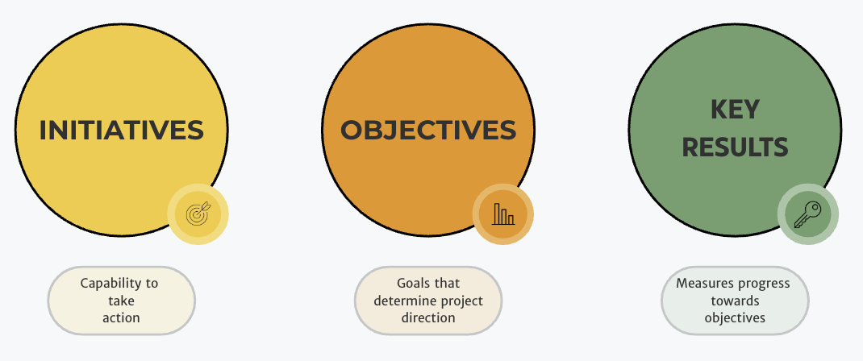
Statement
A Statement entity specifies text referenced by the knowledge base and usually contained in an Artifact
A Requirement entity identifies a capability, characteristic, or quality factor of a system that must exist
A Verification Requirement entity specifies what is required to confirm that a requirement is satisfied
Other types of of requirements include: functional, performance, safety

Slide 24
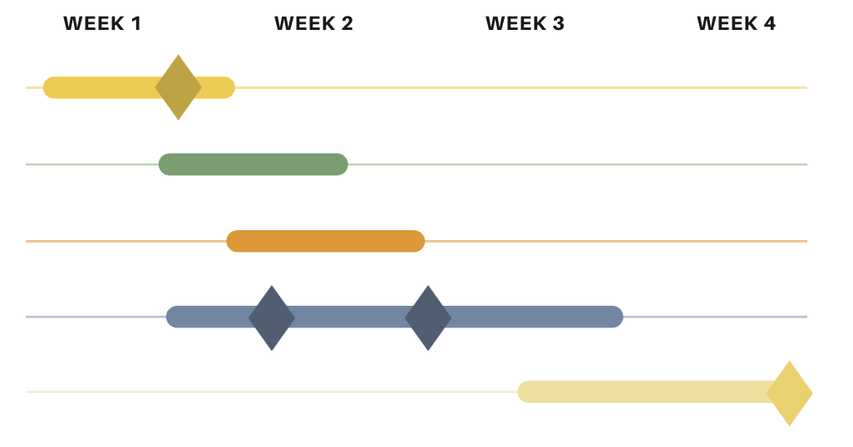
Time
A Time entity specifies a point or period when something occurs or during which an action, asset, process, or condition exists or continues

Slide 25
LML Benefits
A language that effectively communicates will reduce the cost of design
A simple ontology with common graphical notations facilitates understanding of design
LML enables rapid product development to match pace with modern technology

Slide 26
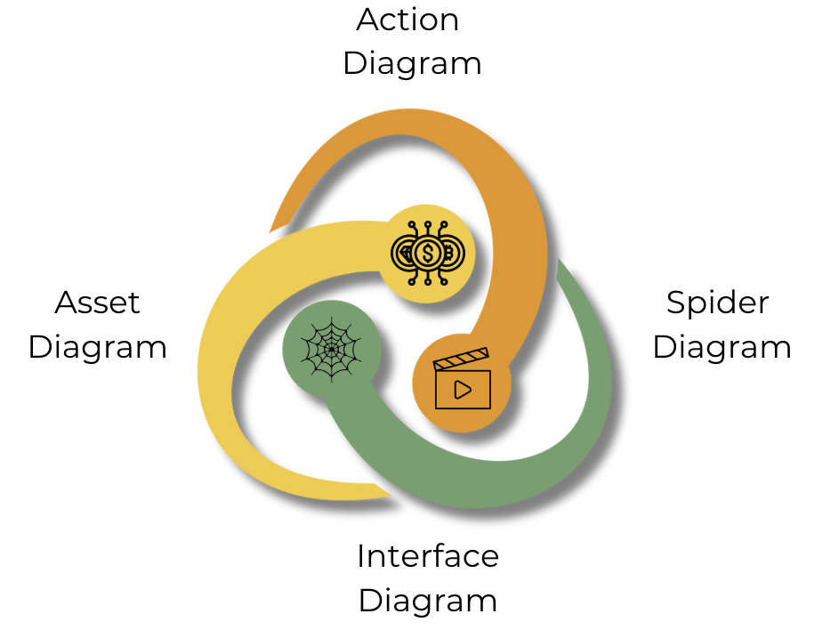
LML Diagram Types
Action
Spider
Asset
Interface

Slide 27
Introduction to Innoslate

Slide 28
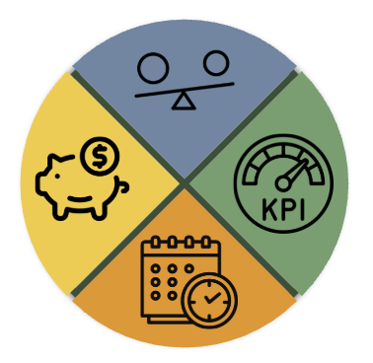
Innoslate
SPEC Innovations flagship tool enables:
Requirements management
Cost management
Systems engineering
Risk management
Project management

Slide 29
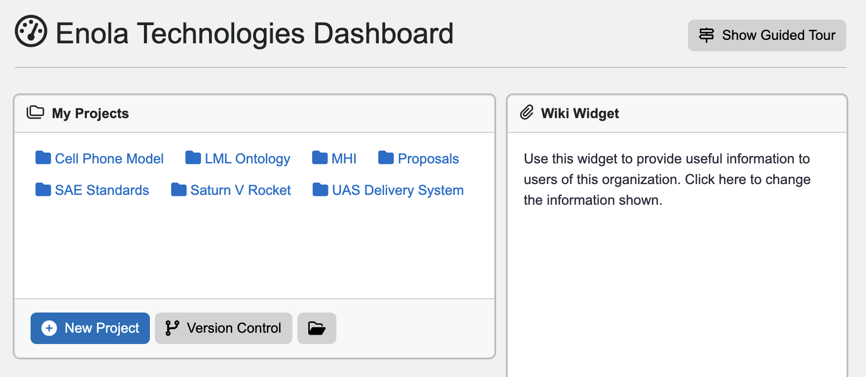

Slide 30
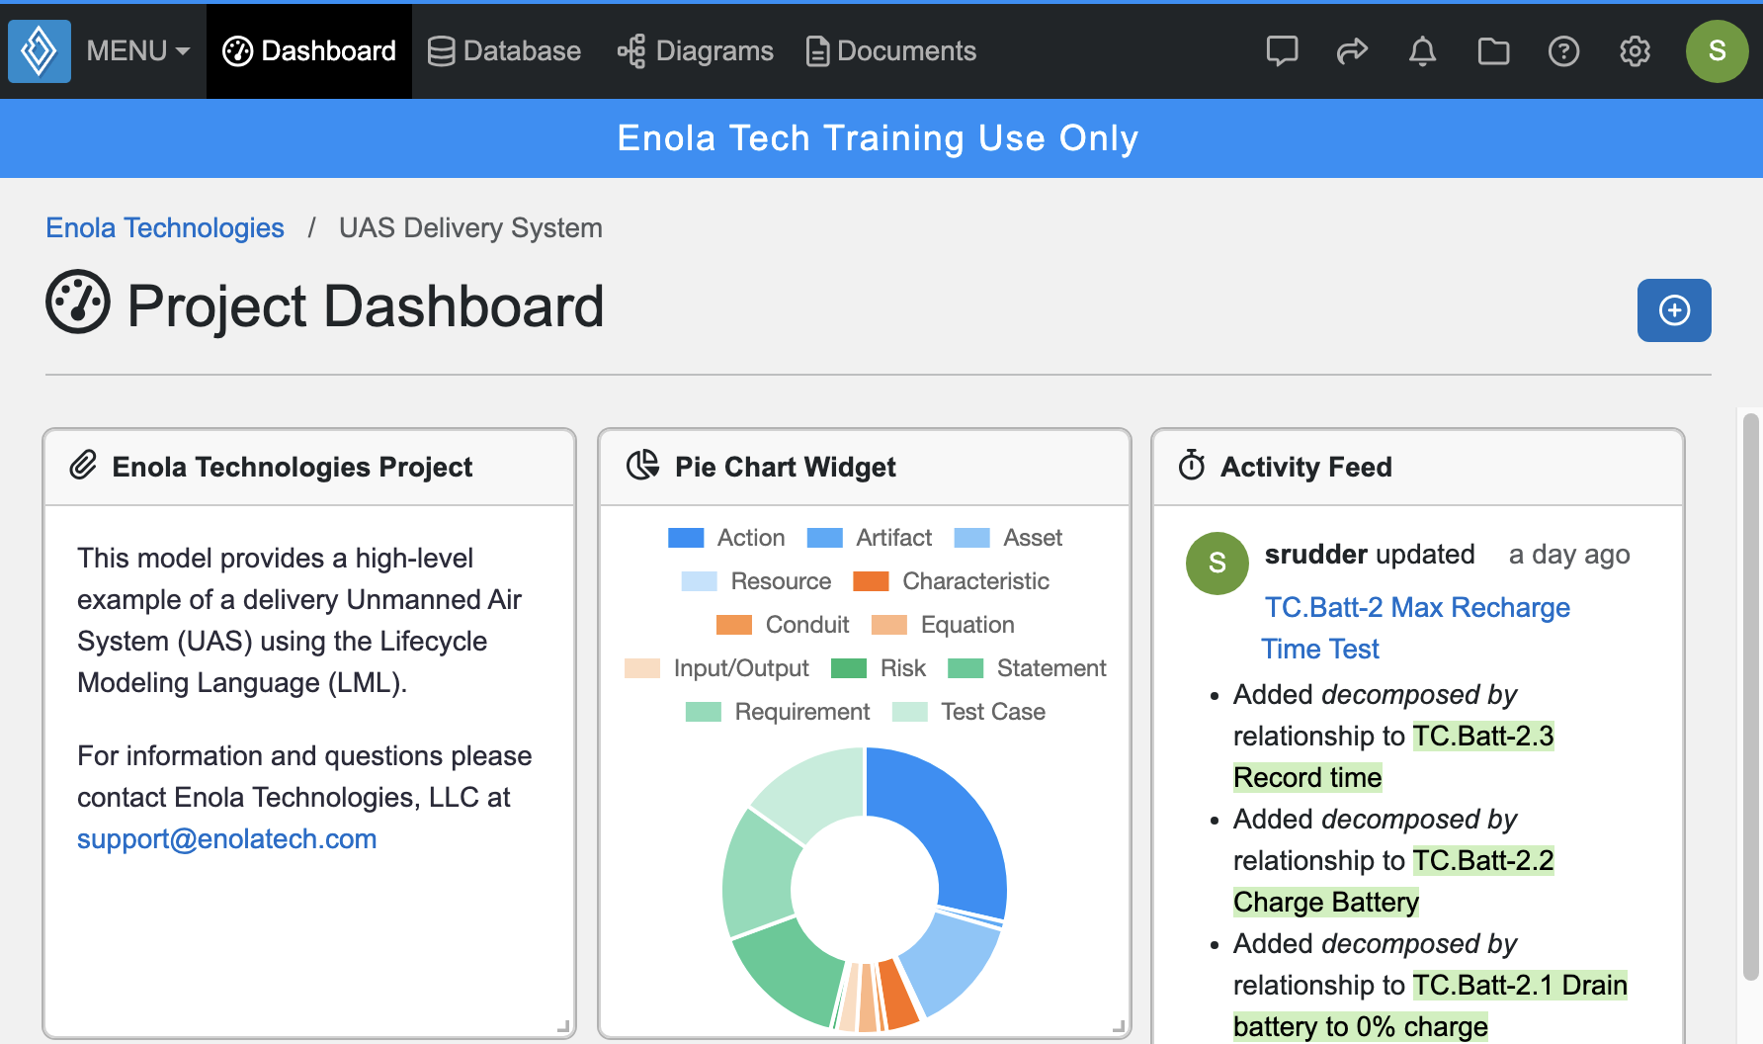
Dashboard View
Add new widgets to personalize your dashboard view
Will only be for your project view
Recommend having the Activity Feed widget

Slide 31
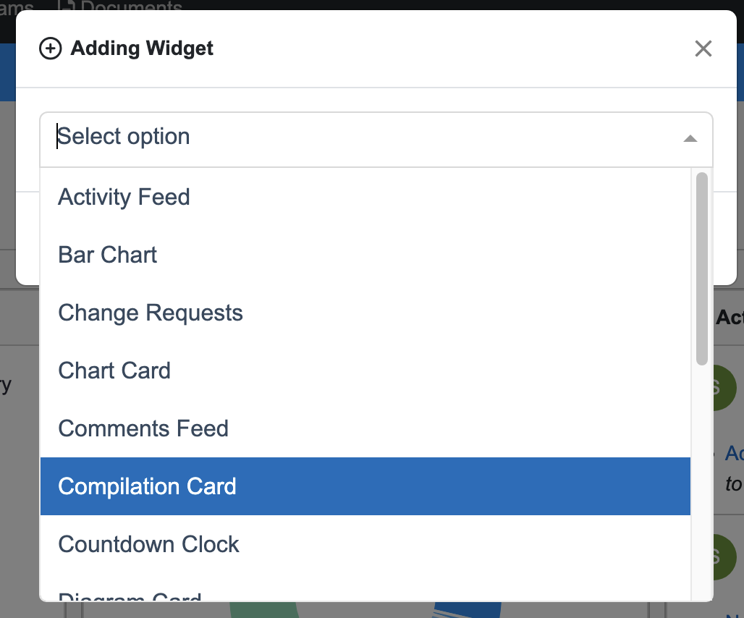
Adding Widgets
Many options to personalize the dashboard view
Does not affect teammates’ dashboard views

Slide 32
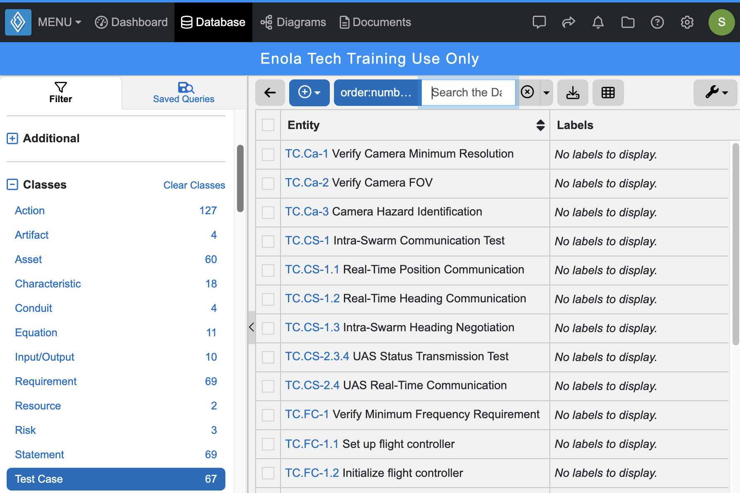
Database View
Represents the actual data repository of the model
Provides an easy way to view entities based on class
Queries can be constructed to use as filters

Slide 33
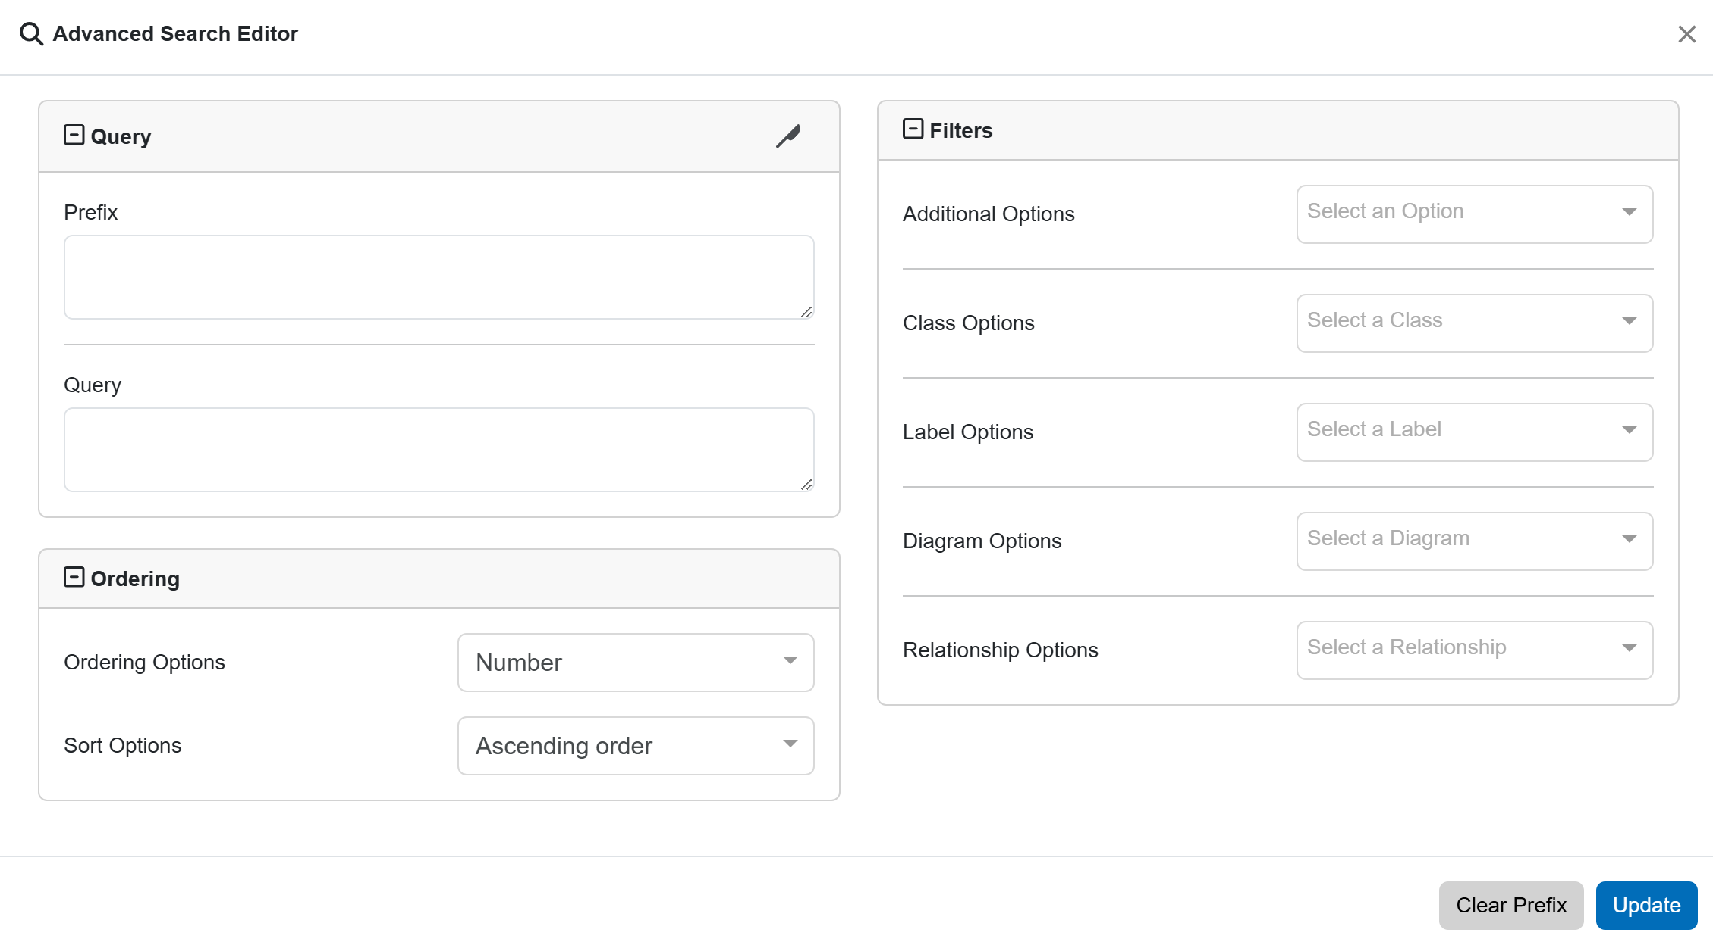
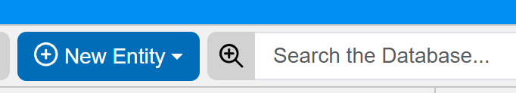
Filtering Database View
Select the magnifying glass with a + sign to open the Advanced Search Editor
Gives Query, Ordering, and Filter options

Slide 34
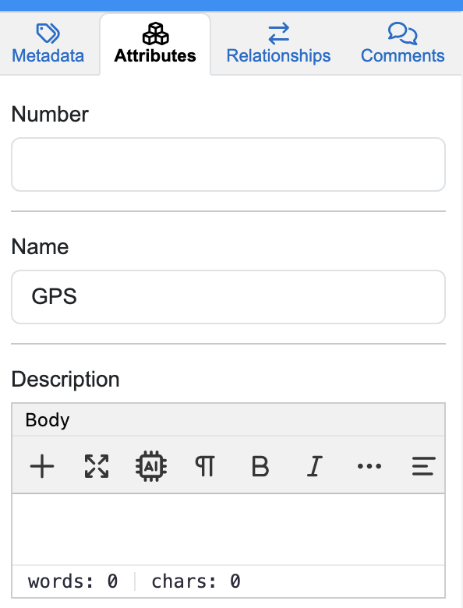
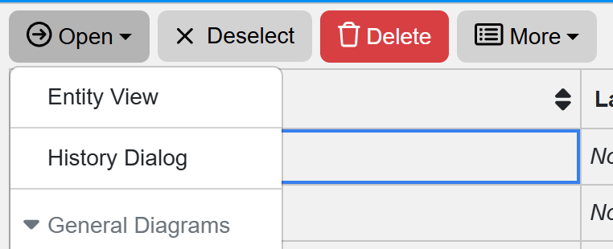
Entity View
Select an entity to modify from the Database View
Options depend on class type
Select Open → Entity View

Slide 35
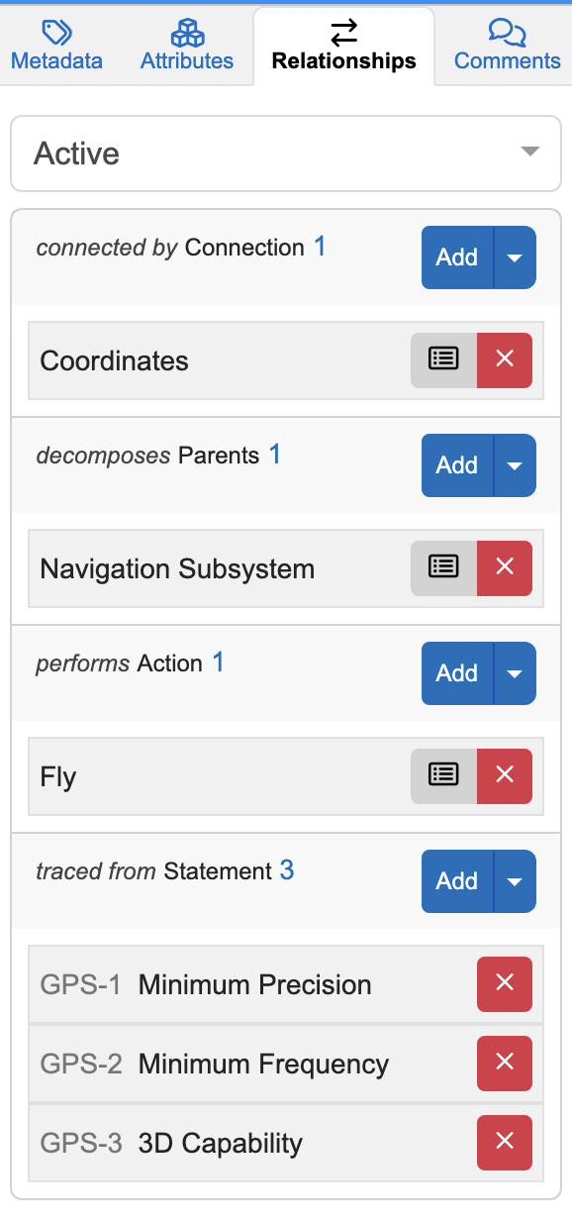
Creating Relationships
Can add/delete LML allowable relationships within the database view
Three views within this tab
Pinned – shows relationships for each class set by the user
Active - relationships which currently exist for this model entity
All – every relationship possible for this class.

Slide 36
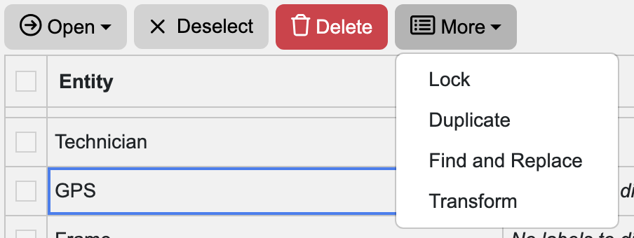
Transforming Entities
Ability to transform a model entity into another class type from the database view
New entity will not retain invalid attributes and relationships from the original entity

Slide 37
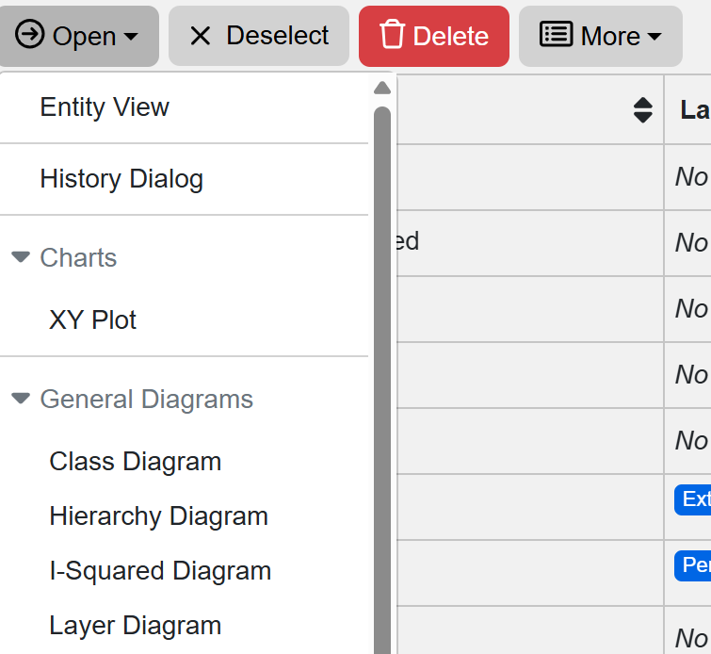
Creating Diagrams from Entities
Generates a diagram view based on the selected entity

Slide 38
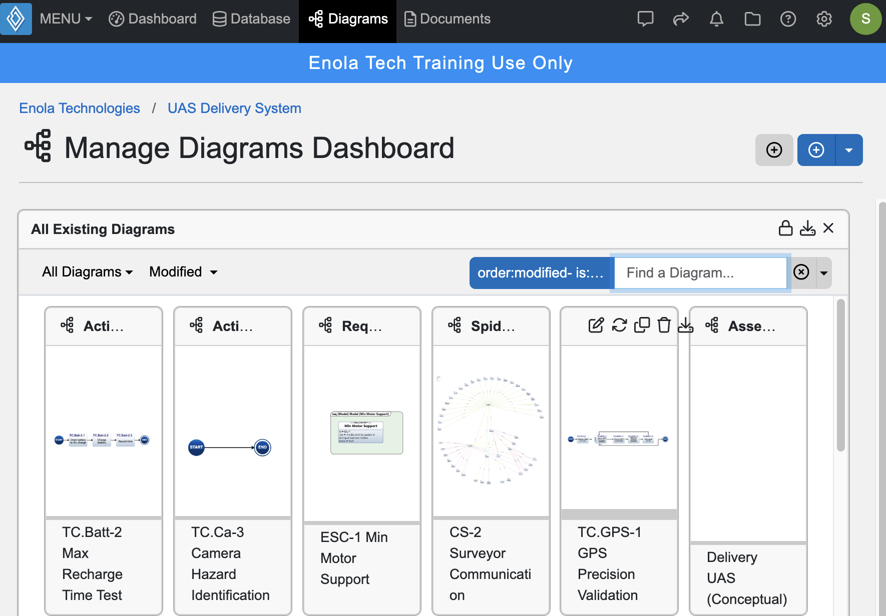
Diagrams View

Slide 39
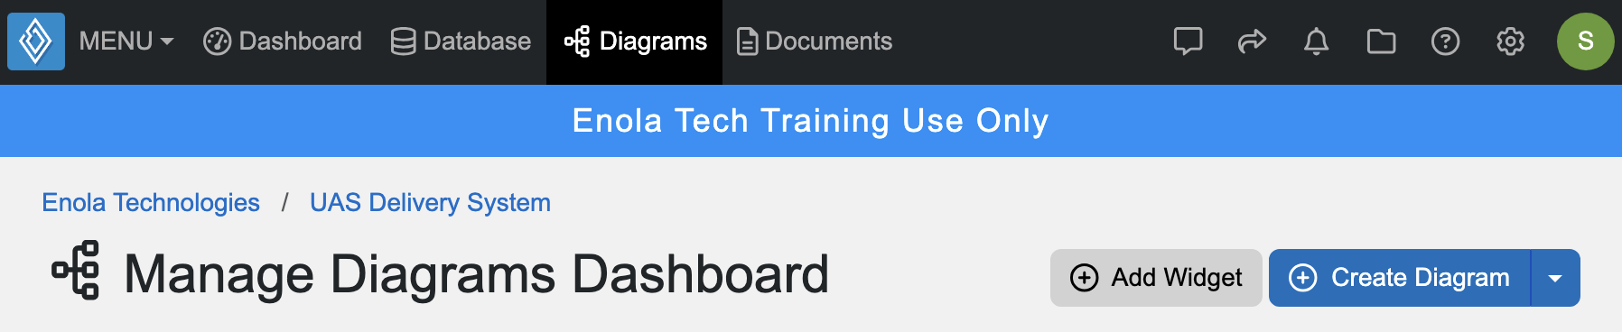
Create New Diagram
New diagrams can be created with new or existing model entities

Slide 40
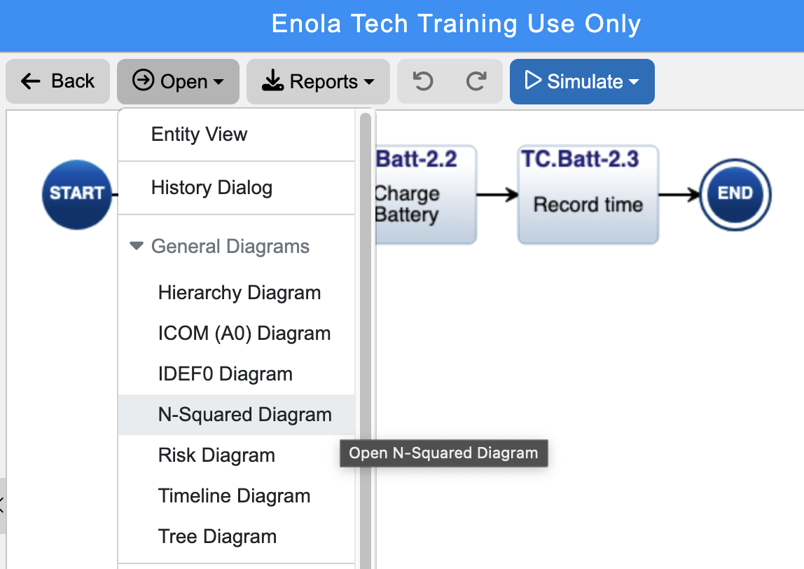
Create New View

Slide 41
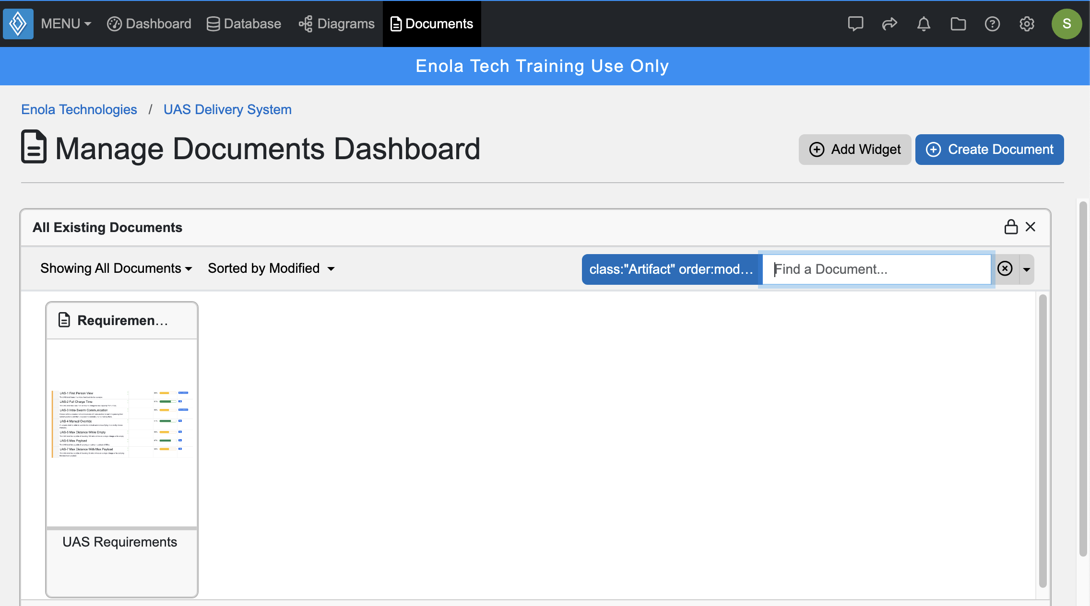
Documents View

Slide 42
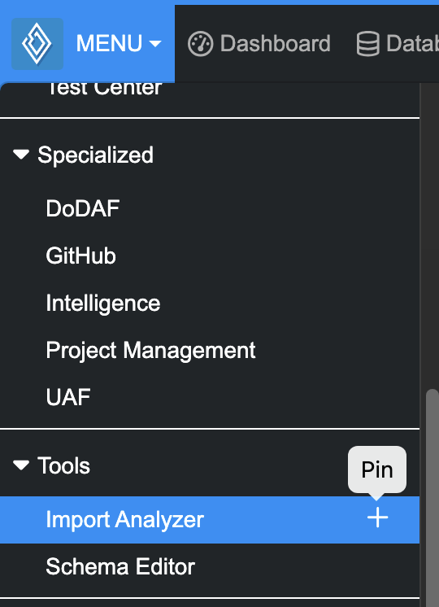
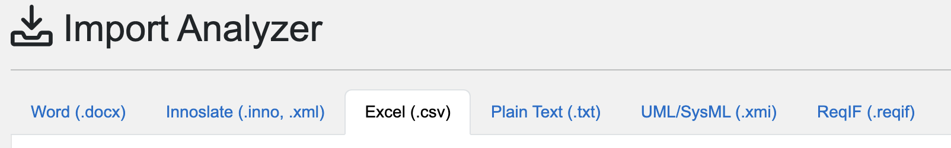
Import Analyzer

Slide 43
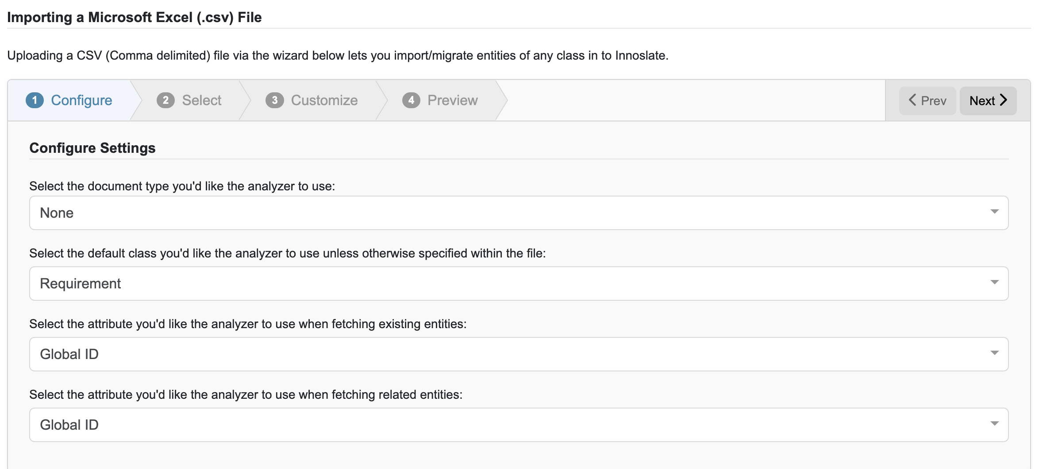
Configure Import

Slide 44
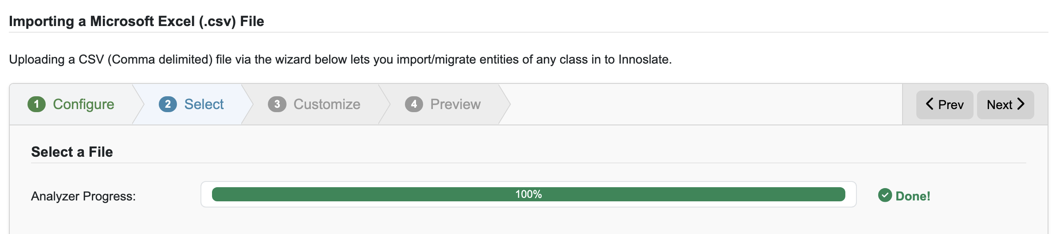
Select Import

Slide 45
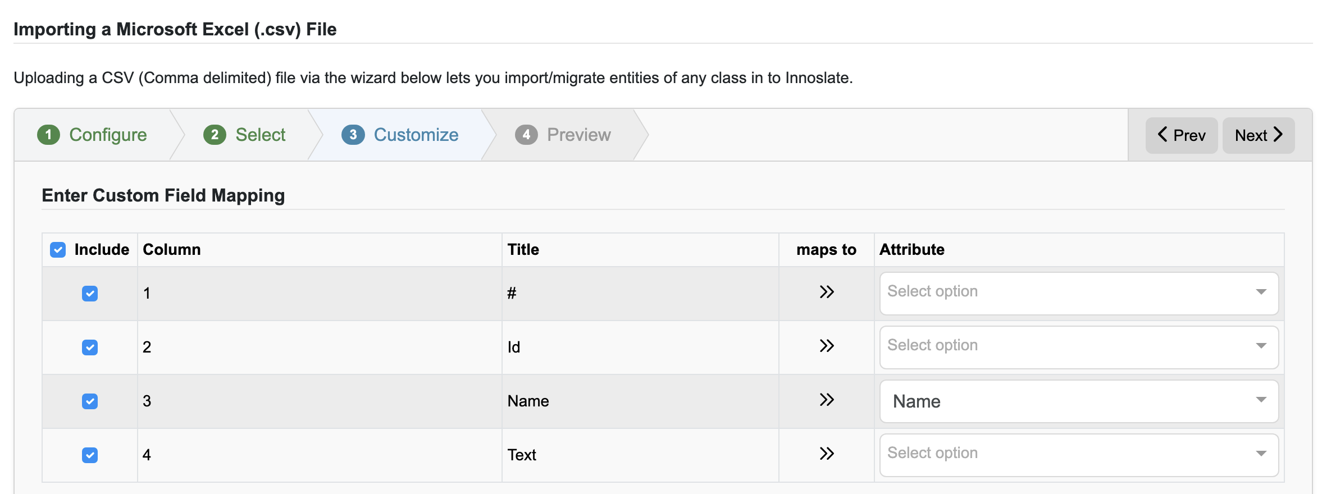
Customize Import

Slide 46
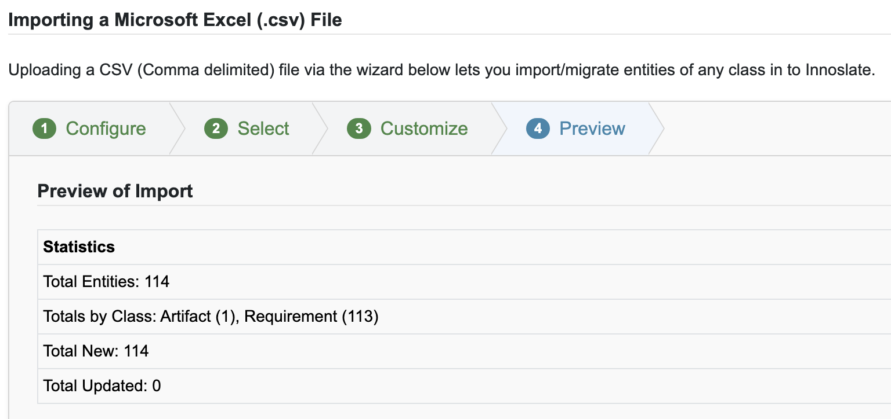
Preview Import

Slide 47
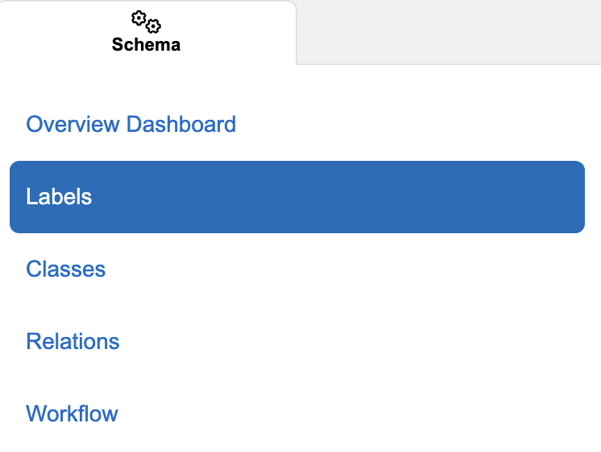
Schema Editor
Most often used to add project or organization-specific Labels
Recommended to not adjust Classes or Relations
Workflow management for change requests/issues

Slide 48
Innoslate Demo
Notes:
4 main views
Import analyzer – import xmi file, import excel
tabs for document entities (metadata, labels)

Slide 49
Requirements
Requirements must be SMART
Define what the system must do without a particular solution
Typically a “shall” statement
Can be derived from multiple sources
High-level requirements come from upper-tier documents such as a Contract or SOW
Low-level requirements are derived from high-level requirements and allocated to specify system components that will satisfy the design constraint

Slide 50
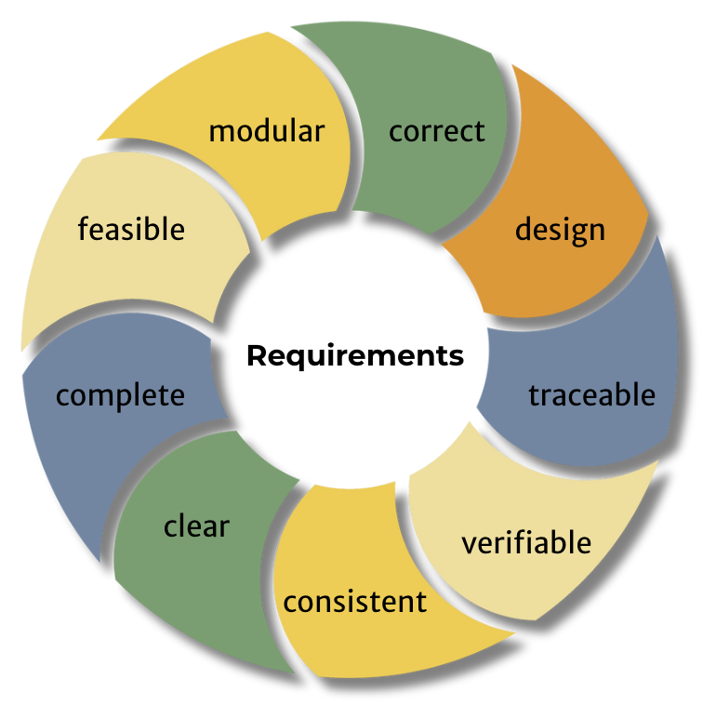
Requirements Management
Processes include requirements development, analysis, and tracking throughout the entire project lifecycle
Reduces project risk by minimizing scope creep, improving communication and collaboration, and ensuring stakeholder needs are met in design

Slide 51
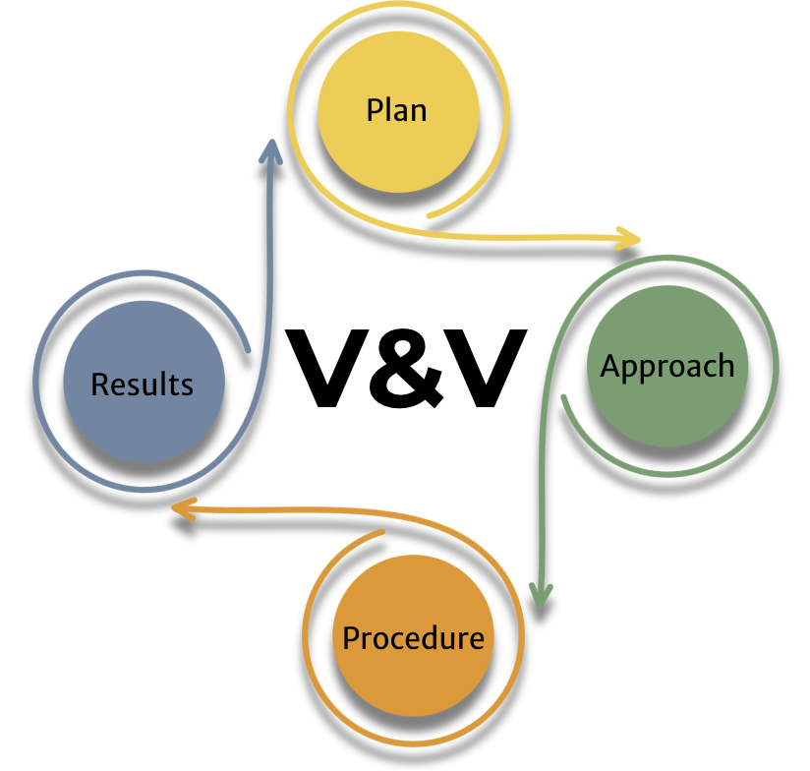
Requirements V&V
Requirements verification - the design is right
Requirements are verified through either an analysis, demonstration, inspection, or test (ADIT)
Analysis
Demonstration
Inspection
Test
Requirements validation - the right design
The final solution meets all stakeholder needs
Notes:
Car example for v&v

Slide 52
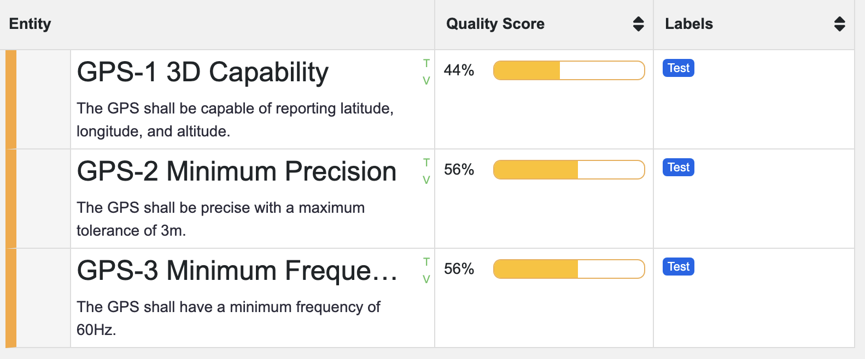
Creating Requirements
Requirements can be imported from other sources (e.g., Microsoft Excel)
They can also be created directly within Innoslate
Each requirement is given an entity ID
A “true” requirements management tool (e.g., IBM DOORS, Jama, Visure)

Slide 53
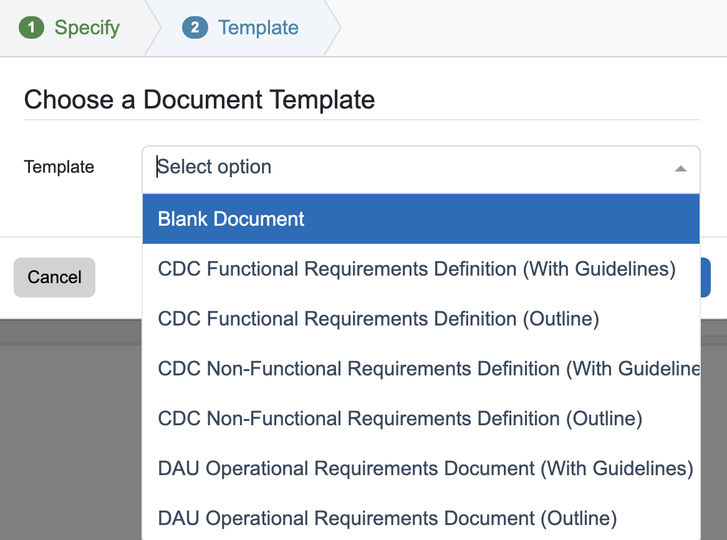
Creating from Scratch
Each type of Document has templates provided
New templates can be created and saved for re-use

Slide 54
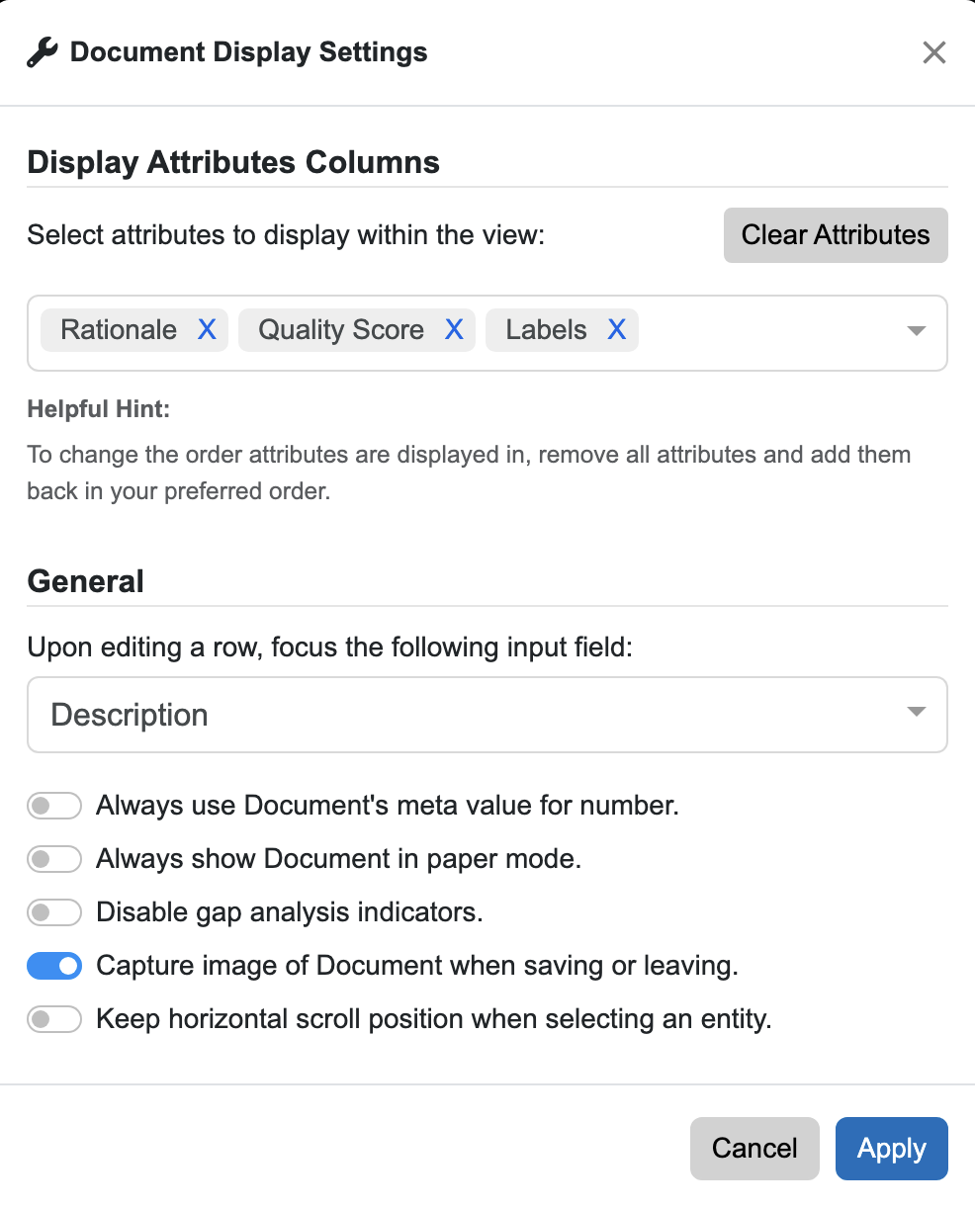
Document Display Settings
Can choose to show/hide columns
Defaults are Rationale, Quality Score, and Labels
Labels typically show
Verification Method
Requirement Type
Environment
Performance
Functional
Interface
Reliability
Safety

Slide 55
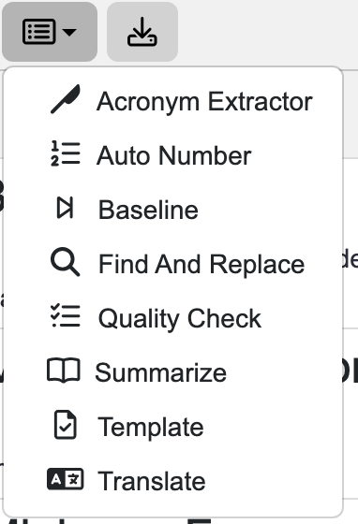
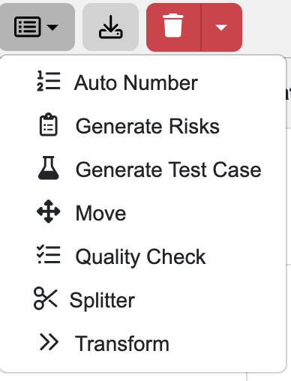
Additional Requirements Capabilities
From the documents view, there are additional options to enhance the quality of requirements
Acronym Extractor
Auto Number
Baseline
Generate Risks
Generate Test Case
Quality Check
Splitter
Translate

Slide 56
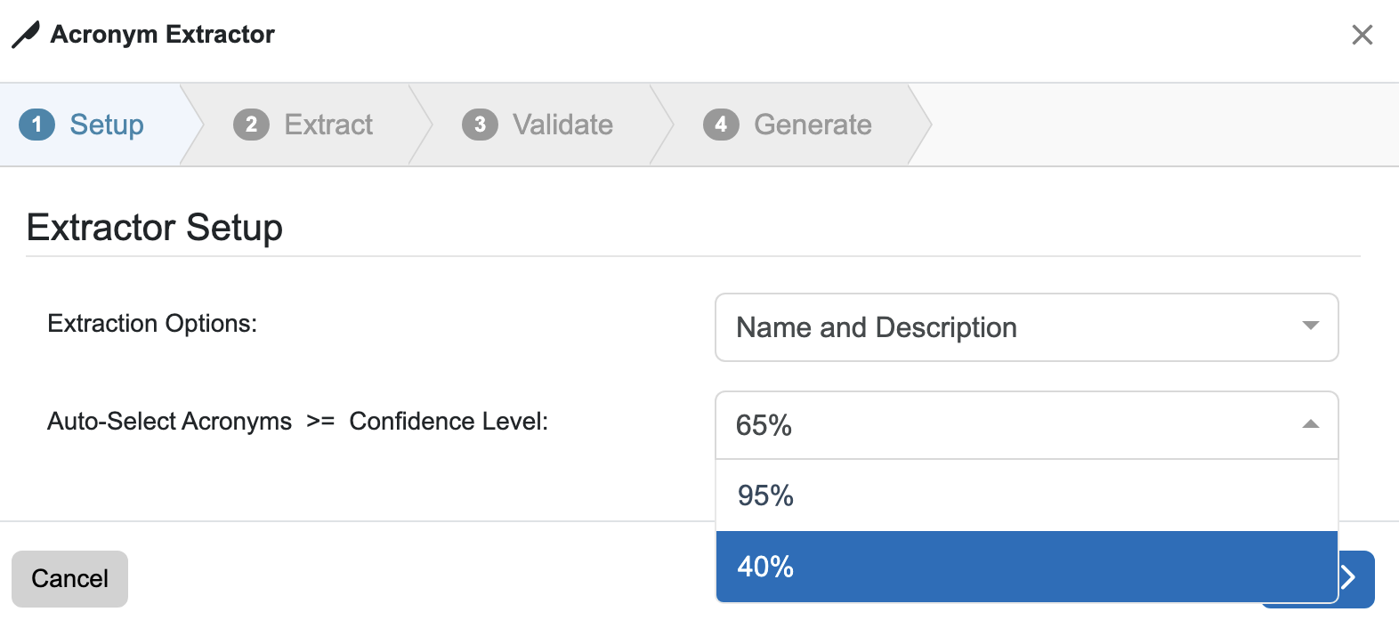
Acronym Extractor
Automatically extracts acronyms for any document
Depends on a person to define acronym at some point within the text
Trust, but verify

Slide 57
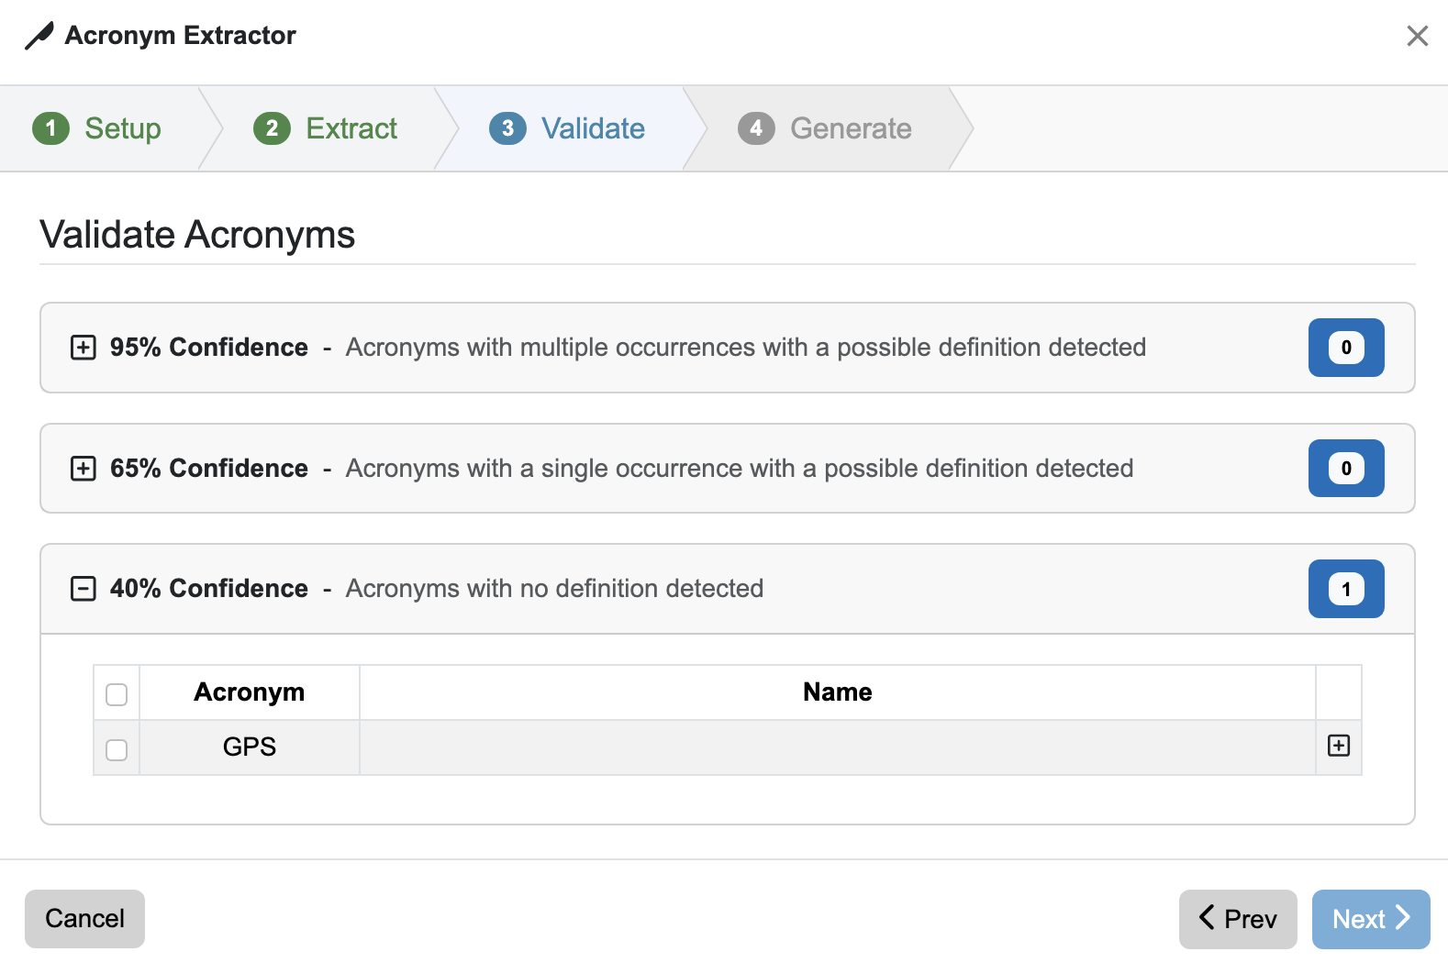
Acronym Extractor Results
Different results based on confidence level chosen
95%
65%
40%

Slide 58
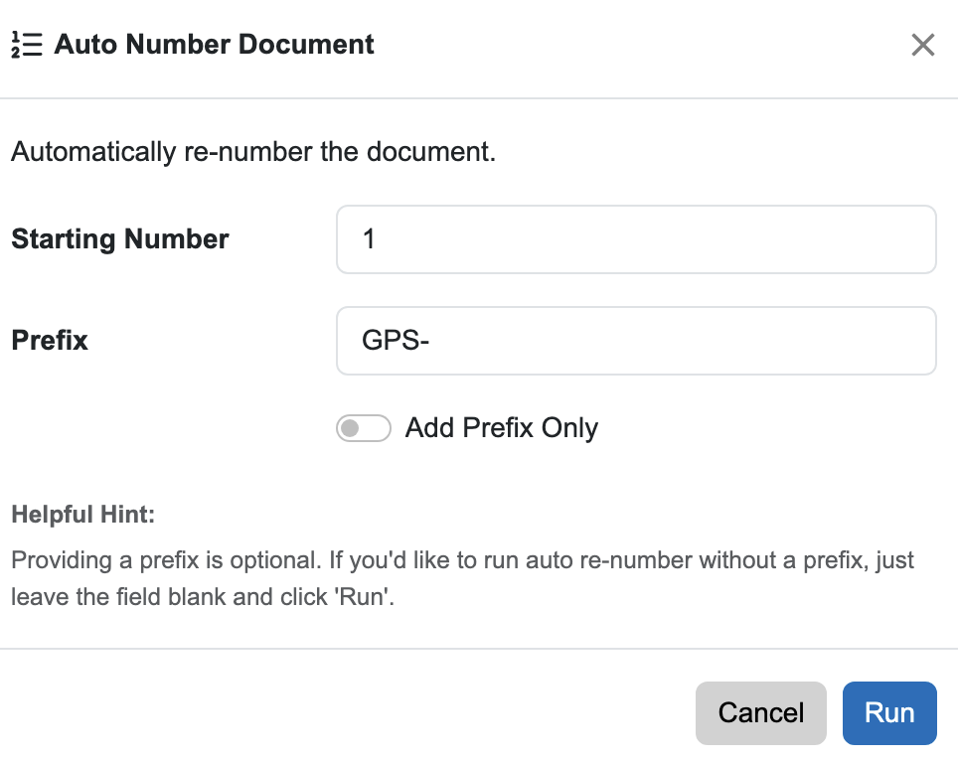
Auto Number
Automatically number requirements recursively with a prefix for a given document

Slide 59

Auto-Generate Risks
Ability to automatically generate up to three risks for each requirement
Still needs to be verified
Provides traceability
Creates:
Description
Consequence
Probability
Risk Label

Slide 60

Generate Test Cases
Ability to automatically generate a test case for each requirement
Creates:
Number
Name
Description
Expected Result
Verification Method

Slide 61

Quality Score
Verifies requirements are adequate based on quality attributes
Appropriate
Complete
Conforming
Correct
Feasible
Necessary
Singular
Unambiguous
Verifiable

Slide 62
Requirement Attributes
Attribute | Type | Description
clear | Boolean | clear represents if this Requirement entity is unambiguous and not confusing.
complete | Boolean | complete represents if this Requirement entity expresses a whole idea.
consistent | Boolean | consistent represents if this Requirement entity is not in conflict with other requirements.
correct | Boolean | correct represents if this Requirement entity describes the user's true intent and is legally possible.
design | Boolean | design represents if this Requirement entity does not impose a specific solution on design; says "what", not "how".
feasible | Boolean | feasible represents if this Requirement entity can be implemented with existing technology, within cost and schedule.
modular | Boolean | modular represents if this Requirement entity can be changed without excessive impact on other requirements.
traceable | Boolean | traceable represents if this Requirement entity is uniquely identified, and able to be tracked to predecessor and successor lifecycle items/objects.
verifiable | Boolean | verifiable represents if this Requirement entity is provable (within realistic cost and schedule) that the system meets the requirement.

Slide 63

Quality Checker
Quality score will update based on manual entries for attributes
Will auto-generate based on the quality of requirements
Recommendations are made to improve requirements

Slide 64

Intelligence Dashboard

Slide 65

Report Generation
Document are necessary to communicate with stakeholders
Purpose of a model is to facilitate construction of SE artifacts

Slide 66
Module 4 Lab Outcomes
Create a Requirements Document
Create Requirements
Add customized Label to the project
Add a Label to entities
Modify columns for Requirements Document
Run the Quality Checker for Requirements
Generate a Risk for Requirements
Generate a Test Case for Requirements

Slide 67
Lifecycle Management Framework (LMF)

Slide 68
Modeling Frameworks
A framework helps organizations align their strategies across various stakeholder viewpoints
Gives an outline that complements a modeling methodology/approach
Must have a standardized language to implement

Slide 69

LMF Mission Domain
Creates the mission value and provides the context for Who, What, Where, Why, and How
After the Mission Domain, the Value Domain realizes the mission value

Slide 70

Lifecycle Stakeholder Questions

Slide 71

Mission Domain Focus Areas
Enterprise Focus—serves as the focal point for concerns of the organization(s) undertaking the mission and include the Enterprise Architecture
Design Focus—the focal point for design concerns including infrastructure and technologies that enable the mission
User Focus—the focal point for all aspects of the user/customer experience including ongoing operations and continuous delivery of capabilities
Implementation Focus—the focal point for all activities and infrastructure needed to turn a design into a product, including procurement, manufacturing, and testing

Slide 72
LMF System Domain
Completed after the Value Domain
Provides the context for all SE processes needed to turn the stakeholder needs into capabilities that deliver value
This includes designing, building, testing, and delivering all systems

Slide 73

System Domain Viewpoints
Opportunity Viewpoint—looks at the situation from the standpoint of what opportunities does the enterprise have or what problems need to be solved
Solution Viewpoint—examines and determine solutions to the problem defined by the opportunity viewpoint
Execution Viewpoint—includes the practical, programmatic, and enterprise efforts needed to turn the solution perspective into reality
DevOps Viewpoint—leverages the capabilities supplied by the execution viewpoint to implement the envisioned solution
Notes:
Solution viewpoint - This includes the bulk of engineering design effort needed to define how the problem will be solved or opportunity realized.
Execution viewpoint - This includes all aspects of strategic project control and execution needed to put in place the infrastructure and organization that will develop and operate the solution.
DevOps viewpoint - This involves the tactical aspects of product development (including integration and verification) as well as operations and sustainment.

Slide 74
System Domain Deliverables
Opportunity Viewpoint Evidence
Scope Model
Requirements Model
Solution Viewpoint Evidence
Design solution analyses models
Detailed Functional and Physical Architecture Models
Execution Viewpoint Evidence
Cost and Schedule Models
Risk Models
DevOps Viewpoint Evidence
V&V Planning Models
ConOps Models

Slide 75


Slide 76

Mission Systems Architecture
Answers the question “What is the system?”
This physical architecture connects top-down System Design to bottom-up System Implementation

Slide 77

Mission Value Stream Architecture
Answers the question “What does the system together with the enterprise do?”
This functional architecture connects the Enterprise to the Users and defines the sequence of capabilities
Notes:
needed to deliver value to users/customers for a specific mission area (and return some form of compensation to the Enterprise in turn, in some cases indirectly e.g. government projects)

Slide 78

LMF Approach
Notes:
Relate to UAF and the process guide and UAFML

Slide 79

Minimum Viable Model (MVM)
What does the system do?
Detailed Functional Architectures
What is the system?
Detailed Physical Architectures
Interface Architecture

Slide 80
Structural Architecture

Slide 81

LML Asset Diagram
Shows the structural composition of a system and item flow between the components​
Connection - specifies the means for relating Asset instances to each other​
Conduit - specifies the means for physically transporting Input/Output entities between Asset entities. ​
Asset - specifies an object, person, or organization​
Resources - specifies a consumable or producible Asset

Slide 82

Hierarchy Diagram
Shows the high-level system architecture
Simplifies complex systems by showing very basic relationship
Easy to read and understand
Most general element is typically at the top

Slide 83

Class Diagram
Communicates high-level system structure of classes for a particular Asset
Can show attributes and operations
Not concerned with interactions between components

Slide 84


I2 Diagram
Focused on information exchange between components to enhance understanding of interdependencies
Rows and columns represent different components
Shows potential communication channels
Facilitates communication planning
Identifies communication bottlenecks

Slide 85

Physical I/O Diagram
Shows physical connections, interactions, and information exchange
Provides clarity of information flow
Represents input/outputs between components

Slide 86
Module 5 Lab Outcomes
Create an Asset Diagram
Create a Hierarchy Diagram
Create a Layer Diagram
Create a Risk Matrix
See the relationships created between Assets and other entities

Slide 87
Functional Architecture

Slide 88

LML Constructs
Sequential
Parallel
Selection
Loop
Synchronization

Slide 89

LML Action Diagram
Shows functional flow (i.e., behavior)
Uses the following classes:​
Action (rounded rectangle) - specifies the mechanism by which inputs are transformed into outputs​
Input/Output (parallelogram) - specifies the information, data, or object input to, trigger, or output from an Action​
Resource (hexagon) - specifies a consumable or producible Asset​

Slide 90

Relationships in LML Action Diagrams
Seizes - between resources and actions
Consumes – between resources and actions
Flow – between actions

Slide 91

N2 Diagram
Provides a visual representation of system interactions
Rows and columns list the same system components
Intersection cells show how components interact

Slide 92

IDEF0 Diagram
Shows data flow, system control, and functional flow of lifecycle processes
Provides descriptions of enterprise operations
Promotes consistency of element usages and interpretations
Notes:
IDEF0 is used to show data flow, system control, and the functional flow of lifecycle processes. IDEF0 is capable of graphically representing a wide variety of business, manufacturing and other types of enterprise operations to any level of detail. It provides rigorous and precise description, and promotes consistency of usage and interpretation.

Slide 93

ICOM (A0) Diagram
Input/Output and Control Mechanisms (ICOM)

Slide 94

LML Constructs Overview
All actions are rectangles
Specialized actions (i.e., constructs) have a diamond overlay
Allows easy identification of decision points
Can allocate these decision points to the performer

Slide 95

Sequential
Requires an action to complete prior to the subsequent action

Slide 96

Parallel
Actions to be performed in parallel
More than two branches are created
More than one action can be placed on a branch

Slide 97
Selection
OR node
Name should be a question
Yes/No are default conditions

Slide 98

Synchronization
The SYNC point represents the decision on whether to wait for the completion of Action A and Action B prior to starting Action C
Typically occurs when Action A and Action B are performed by different entities

Slide 99


Loop
Represents conditions to enter and exit the LOOP
Can set a range for iterations or have conditional entry/exit criteria

Slide 100

Traceability
LML action diagrams do not contain swimlanes
Assets perform actions
Branch Asset can be assigned to branches
Relationship can be created in the entity view or a traceability matrix

Slide 101

Traceability Matrix

Slide 102

SysML Activity Diagram
Innoslate supports SysML activity diagrams
Automatically generated based on LML Action Diagram

Slide 103
LML Mapping to v2.0
Connection
 | ConnectionDefinition
 | ConnectionUsage
 | FlowConnectionDefinition
 | SuccessionFlowConnectionUsage
Decision | DecisionNode
Dependency | Dependency
Equation | FeatureReferenceExpression
 | NullExpression
 | OperatorExpression
Input_Output | ItemDefinition
 | ItemFlow
 | ItemUsage
Measure | AssertConstraintUsage
 | CalculationUsage
 | ConstraintDefinition
Port | PortDefinition
Requirement | RequirementUsage
 | SatisfyRequirementUsage
 | VerificationCaseDefinition
Requirement Verification Requirement | RequirementVerification
Statement | Comment
 | ReferenceUsage
 | TextualRepresentation
LML v2.0 | SysML v2
Action | AcceptActionUsage
 | ActionDefinition
 | ActionUsage
 | ForkNode
 | IncludeUseCaseUsage
 | Interaction
 | JoinNode
 | MergeNode
 | PerformActionUsage
 | Step
 | SuccessionAsUsage
 | UseCaseDefinition
Asset | PartDefinition
 | PartUsage
Characteristic | AttributeDefinition
 | AttributeUsage
 | EnumerationDefinition
 | EnumerationUsage
 | Feature

Slide 104
Mob 6 Lab Outcomes
Create an LML Action Diagram
Represent control logic
Show inputs, outputs, and resources within the context of system behavior
Elaborate Test Case behavior
Create an LML Spider Diagram

Slide 105
Simulation with Innoslate

Slide 106

Simulation
Discrete Event - specific occurrence that happens at a particular point in time, which causes a change in the state of a system
Monte Carlo - a technique that uses random sampling to model and analyze complex systems or processes.
Each event represents one possible scenario based on random inputs,
Helps estimate probabilities, averages, or distributions

Slide 107
Discrete Event Simulation

Slide 108


Discrete Event Simulation

Slide 109

Discrete Event Simulation
Status – shows which action is currently executing
Time Simulation
Default time of each action to complete is 1 hour
Evaluating long-term effects of decisions
Cost Simulation
No default cost
More informed decision-making
Budget planning

Slide 110


OR Action
LOOP Action

Slide 111

Simulation Deadlock
Carefully manage the relationships between Actions, Resources, and Inputs/Outputs
Ensure that the correct relationships (such as produces, consumes, or seizes) are established

Slide 112

Debugging

Slide 113


Additional Simulations

Slide 114
Module 8 – Project Management

Slide 115

Kanban Board
Provides visualization of a team’s workflow
Tasks are shown in columns based on status (e.g., open, in review, closed)
Helps teams manage work-in-progress (WIP)
Notes:
a visual project management tool that illustrates a team's workflow using columns and cards to represent tasks, helping teams manage work-in-progress (WIP), track task status at a glance, and maximize efficiency.

Slide 116



Kanban Board View

Slide 117


Gantt Chart View

Slide 118
Comments/Questions?

